Slide 1




Year 2023
What’s Next
IMDEX Innovation Challenge at
IMDEX Asia 2023
3 – 5 May 2023

Slide 2


IMDEX Innovation Challenge
RCA-UMSA 2023 & IMDEX Asia 2023
Exhibitions & Conferences
The 13th edition of IMDEX Asia will be held on 3 – 5 May 2023 at Changi Exhibition Centre in Singapore. IMDEX Asia 2023 will be held in conjunction with RCA-UMSA.
As the leading exhibition and conference on the Asia Pacific naval, maritime security and defence industries, IMDEX Asia offers unrivalled access to opportunities in the high-growth regional markets.
© Experia Events Pte Ltd. All Rights Reserved Certified with the Data Protection Trustmark (DPTM), ISO27001 and SG SafeEvent

Slide 3
IMDEX Innovation Challenge
IMDEX Asia 2023
IMDEX Asia 2023 areas of focus:
  Naval Platforms and Systems
  Maritime Security – Physical & Cyber
  Underwater Platforms and Systems
  Training and Simulation
  AI, Digitalisation & IOT
  Autonomous Systems
© Experia Events Pte Ltd. All Rights Reserved Certified with the Data Protection Trustmark (DPTM), ISO27001 and SG SafeEvent

Slide 4

IMDEX Innovation Challenge
What’s Next is a unique platform for start-ups to showcase their products to potential customers, partners and investors at iconic events like the Singapore Airshow, Rotorcraft Asia, Unmanned Systems Asia and IMDEX Asia.
Access to potential buyers, partners and investors from around the world from top corporates and government agencies.
Offers exhibition kiosks, pitching sessions and B2B meetings, networking events/opportunities and technology seminars.
© Experia Events Pte Ltd. All Rights Reserved Certified with the Data Protection Trustmark (DPTM), ISO27001 and SG SafeEvent

Slide 5
IMDEX Innovation Challenge
Calling for Start-Ups involved with…
Advanced Manufacturing
Aerospace and Aviation
Augmented/Virtual Reality
Artificial Intelligence
Autonomous Vehicles/Systems
Big Data and Data Analytics
Cyber Security
Digitalisation
Energy Systems
Green/Sustainable Technologies
IoT and Machine Learning
Marine and Offshore
Maritime Technologies
Robotics
Smart Transport
Underwater Technologies
Unmanned Systems
Urban Solutions/Mobility
© Experia Events Pte Ltd. All Rights Reserved Certified with the Data Protection Trustmark (DPTM), ISO27001 and SG SafeEvent

Slide 6
IMDEX Innovation Challenge
Event Information – IMDEX Asia
IMDEX Asia 2019 statistics:
11,013 trade attendees from 62 countries/regions
236 exhibiting companies from 30 countries
67 VIP delegations from 42 countries
Including 26 Chiefs of Defence Force, Navies, Vice Chiefs and Directors-General of Coast Guard
25 foreign warships from 15 countries
650 meetings between exhibitors and VIP delegations
Attendees Profile
Armed forces, navies, coast-guards, para-public organisations
Defence Consultants, Technologists and Systems Integrators
Simulation and Training Providers
Shipbuilders and Ship MRO
Port Operators
Maritime Communications
Maritime Security
Navigation and Survey
© Experia Events Pte Ltd. All Rights Reserved Certified with the Data Protection Trustmark (DPTM), ISO27001 and SG SafeEvent

Slide 7
IMDEX Innovation Challenge 2023
IMDEX Innovation Challenge
Starburst will be running the IMDEX innovation challenge in collaboration with Experia to provide a unique platform for startups to showcase their products and solutions to potential customers, partners and investors at IMDEX Asia 2023.
If successfully selected for demo day pitching, there is intention to pilot/deploy these startups' solutions into RSN’s operational units, pushing for adoption into the maritime and defense industry.
Why participate?
Go-to-Market Strategy to gain access to maritime and defence corporates and investors
Potential for a pilot project with Republic of Singapore Navy if successfully selected
© Experia Events Pte Ltd. All Rights Reserved Certified with the Data Protection Trustmark (DPTM), ISO27001 and SG SafeEvent

Slide 8
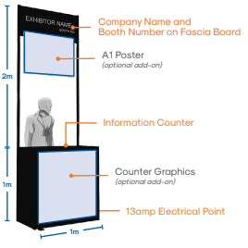
Challenge Details
IMDEX Innovation Challenge
Physical Presence at the Exhibition
Standard Start-Up Booth (4 sqm) with:
  One information counter
  One 13amp electrical point
  Company name and booth number on fascia board
  Exhibitor profile listing on show directory
  Company logo and profile to be featured on website
A1 poster (optional add-ons)
Counter graphics (optional add-ons)
Demo Day Pitching
Selected Startups stand a chance to pitch their products/services to senior stakeholders of Experia’s network of partners and corporates during the demo day.
Eligibility
Start-Ups should fulfill the following criteria before they are eligible to participate at What’s Next:
  Early to Growth Stage
  With a novel and innovative solution to showcase
  Not representing 3rd party products or technology
  Not a subsidiary of an established company
Participation Fee Package: USD$1000 (+GST if applicable)
Contact asia@starburst.aero for details
© Experia Events Pte Ltd. All Rights Reserved Certified with the Data Protection Trustmark (DPTM), ISO27001 and SG SafeEvent

Slide 9
Challenge Details
IMDEX Innovation Challenge
Specific Problem Statements
Others
How might we have a low-cost solution that is easily deployable (without the need for another support vessel or heavy lifting equipment) to detect and neutralize both underwater diver and unmanned underwater vehicles threats for anchored ships?
How can we carry out survey and inspection checks of ship hulls, with minimal manpower?
How can we perform conditional monitoring and predictive maintenance on Electronics?
Usage of AI to improve trainer to trainee ratio for classroom and practical learning settings.
Sustainable fuel for maritime vessels
Hydrogen fuel cell for maritime and port applications
Weather technologies
Wave energy applications
Carbon Capture, Utilisation and, Storage (CCUS) for maritime
Other innovative/emerging technologies for maritime and defence sector
© Experia Events Pte Ltd. All Rights Reserved Certified with the Data Protection Trustmark (DPTM), ISO27001 and SG SafeEvent

Slide 10
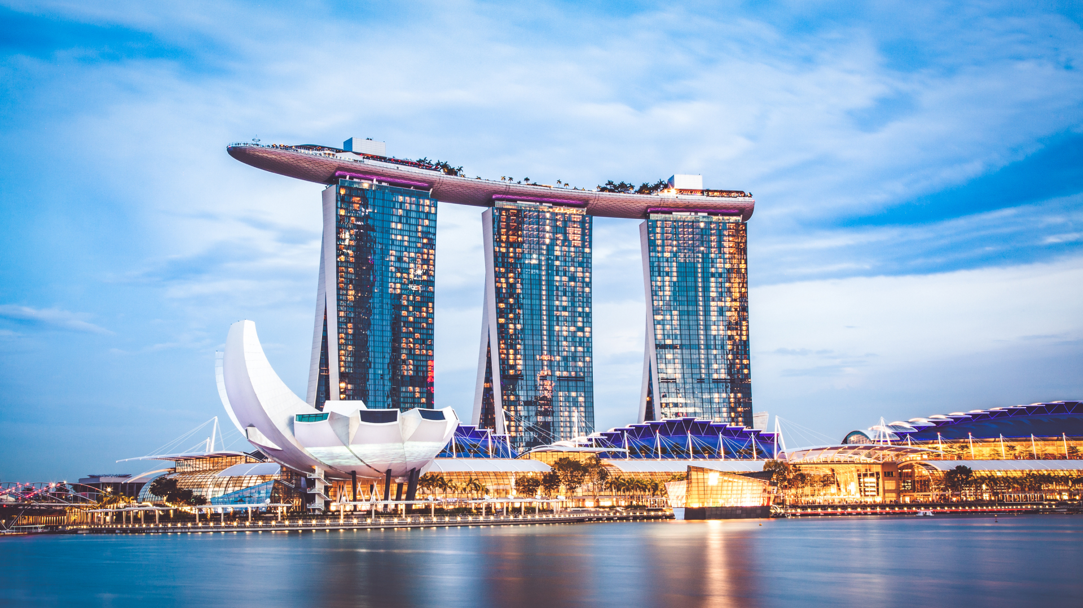

Starburst Aerospace
Year 2022
THE FUTURE IS HERE
Contact the Starburst Asia team today!
asia@starburst.aero
Starburst 2022 © All rights reserved

Slide 11

Starburst
Year 2022
INTERNATIONAL PROGRAM REFERENCES
Starburst 2022 © All rights reserved

Slide 12













































STARBURST HAS A STRONG EXPERIENCE BUILDING ROBUST ACCELERATOR PROGRAMS WITH KEY AEROSPACE & DEFENSE STAKEHOLDERS GLOBALLY
Los Angeles Space Accelerator
INCHEON URBAN AIR MOBILITY
ACCELERATOR
Accelerator
Explore H2
INDIA
ACCELERATOR
Program Industry Focus
Program Partner
Aviation
Space
Defense
Corporate
Government
Government & Corporate

